Slide 1
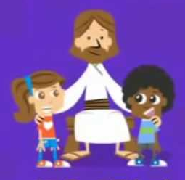
Jesus is my best Friend
Jesus is my best Friend My best Friend My best Friend Jesus is my best Friend He's always there for me

Slide 2
On Sunday, Monday, Tuesday, Wednesday, Thursday, Friday and Saturday Jesus is my best Friend He's always there for me

